Slide 1



Harbor Watch
Home
About
Content
Others
HARBOR WATCH
HARBOR WATCH
HARBOR WATCH
RUNTIME TERRORS:
SRUJA BRAHMBHATT
DEV CHAUHAN
VISMAY SHAH

Slide 2
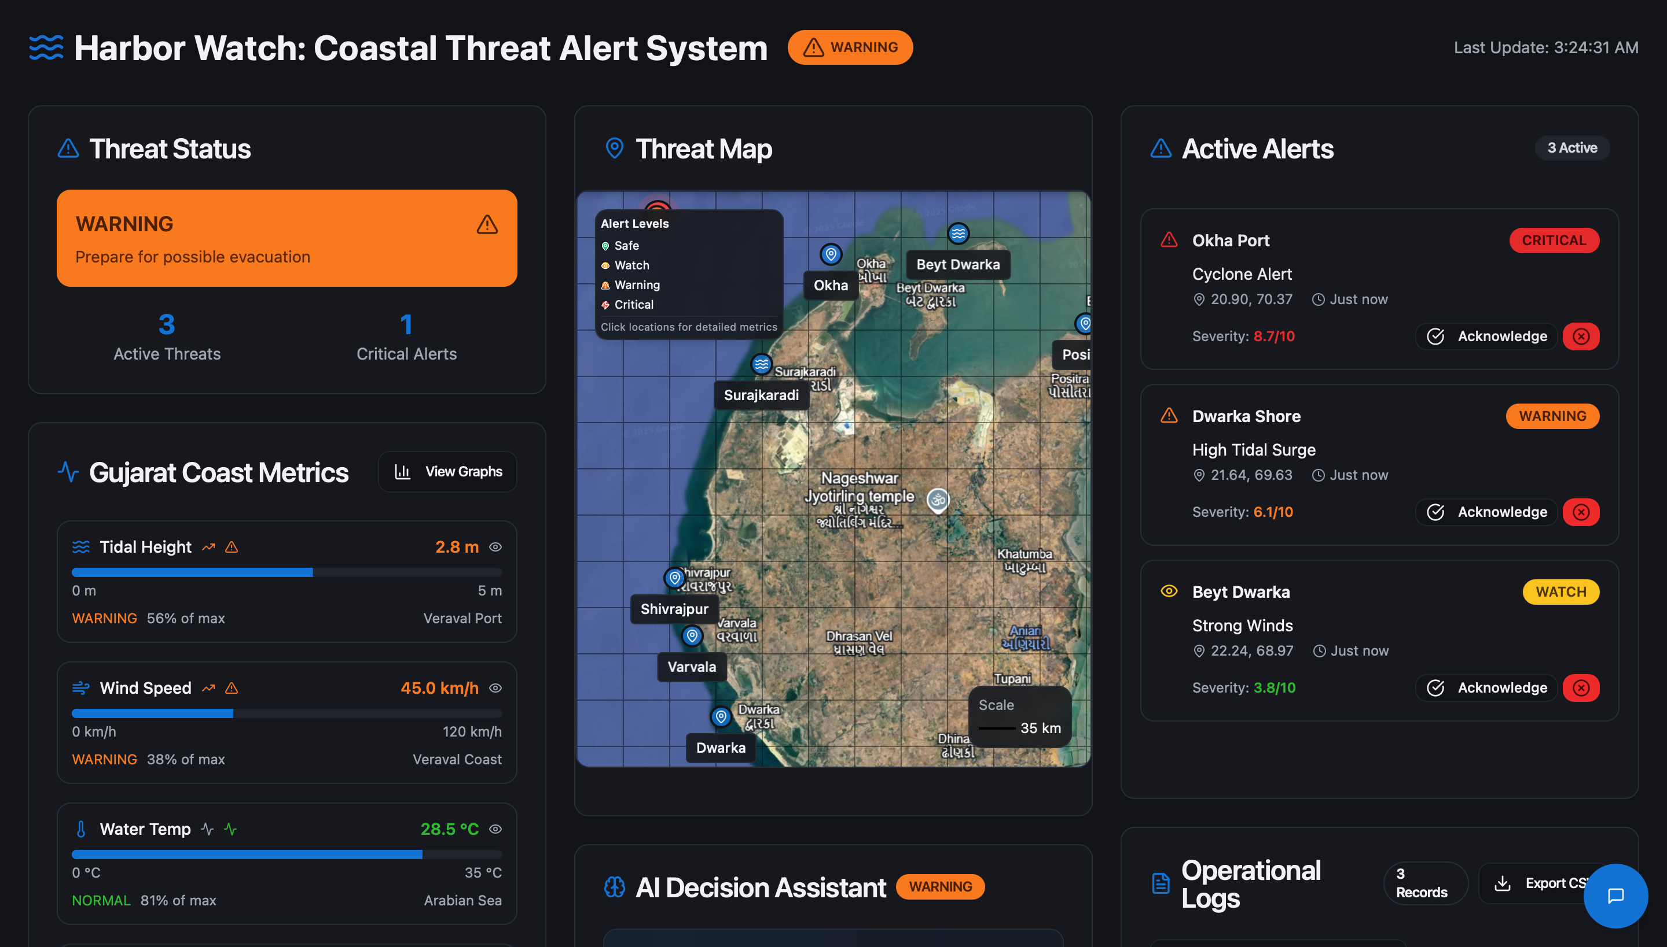

Harbor Watch
Home
About
Content
Others
What we have built
A web application with:
Threat Map
Active Alerts
AI Chatbot and Decision Assistant
Designed for coastal alerts - tides and weather warnings, algae blooms and more.

Slide 3
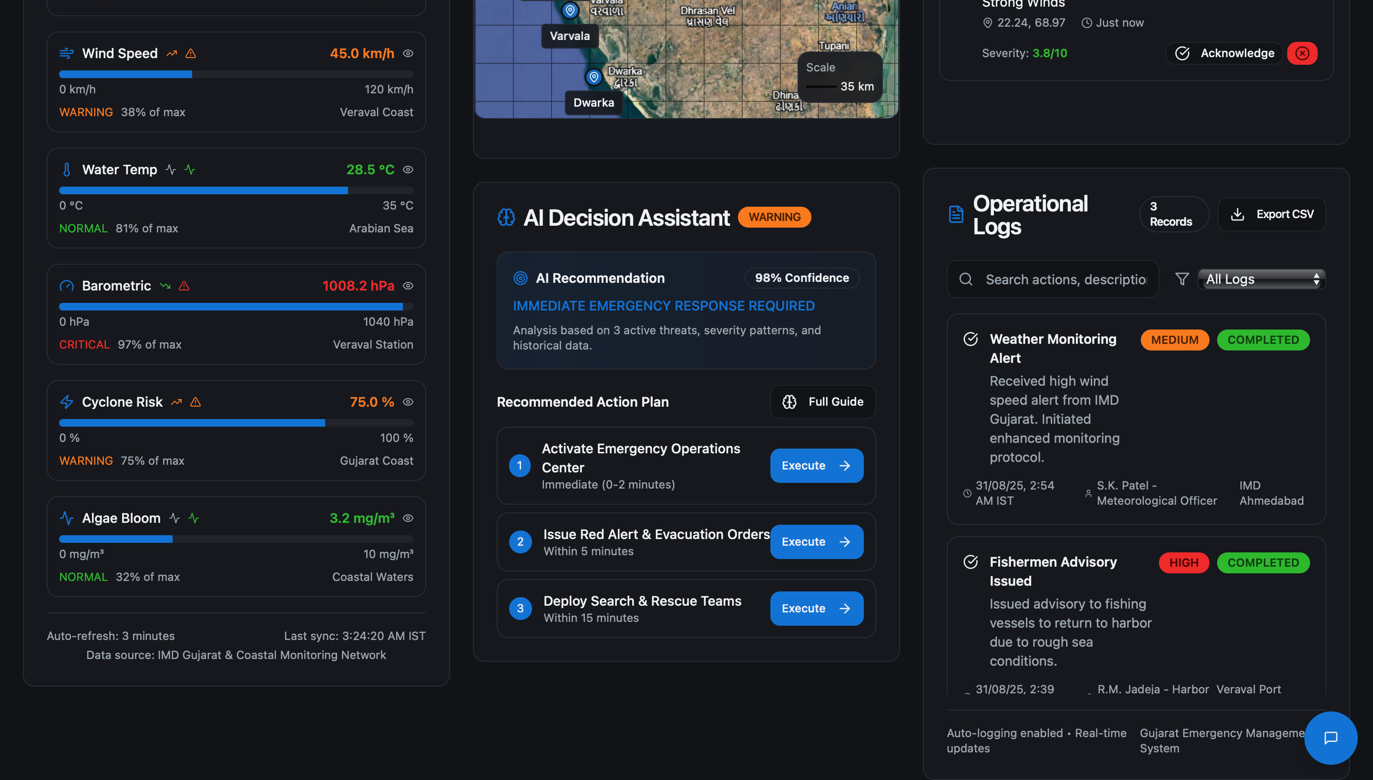
Harbor Watch
Home
About
Content
Others
Live UI: Dashboard
Threat Map is the primary canvas, with side panels containing alert summaries, AI decision makers, Operational Log, Active alerts and threat status.

Slide 4
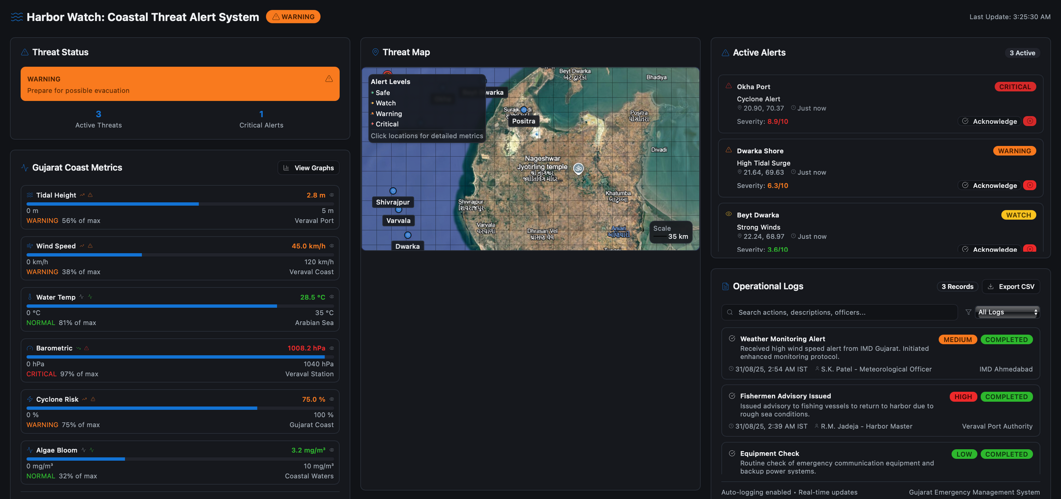
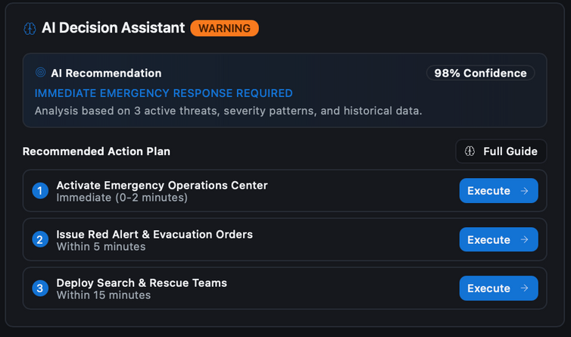
HARBOR WATCH
Harbor Watch

Slide 5
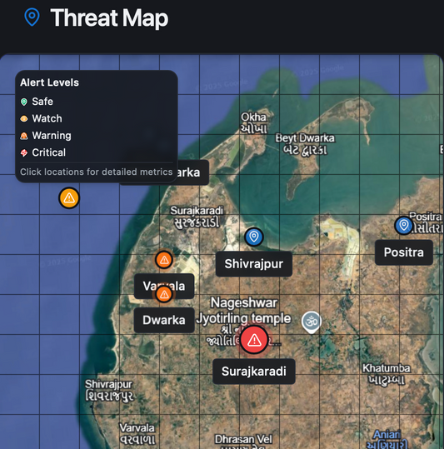
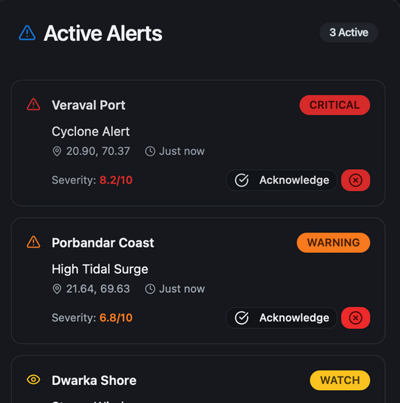
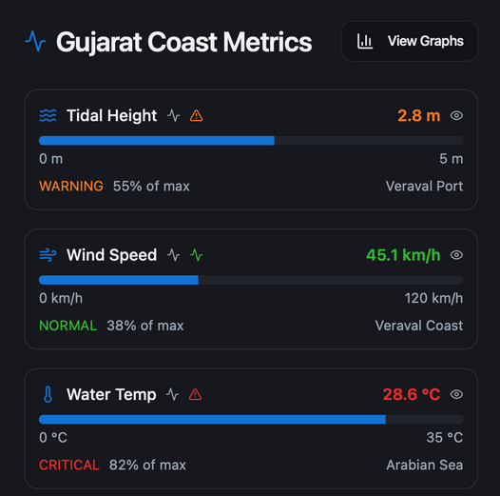
SRUJA
Harbor Watch
Home
About
Content
Others
Feature Overview
THREAT MAPS
ACTIVE ALERTS
COAST METRICS

Slide 6
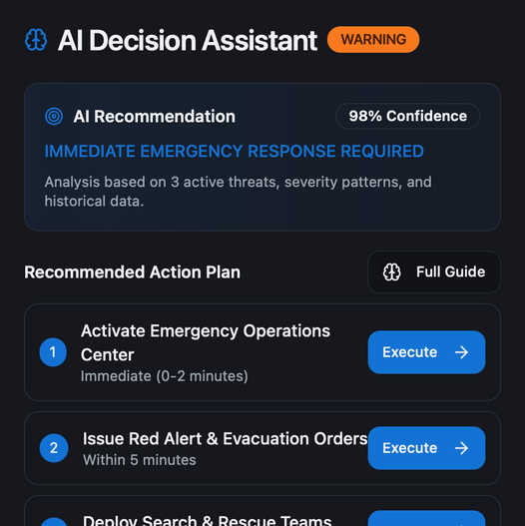
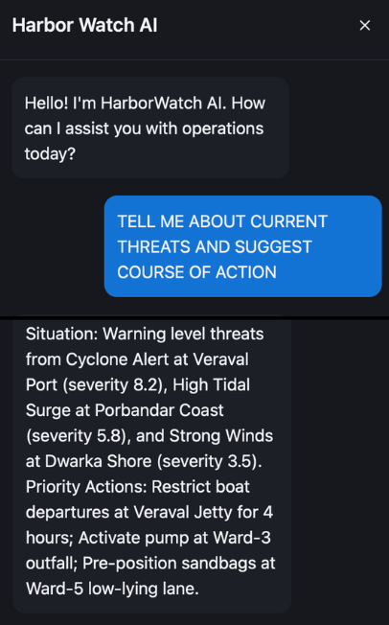
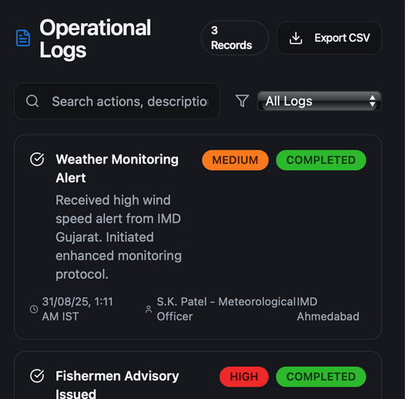
Harbor Watch
Home
About
Content
Others
The USP : Unique Selling Proposition
AI DECISION
ASSISTANT
AI CHATBOT
OPS LOG

Slide 7
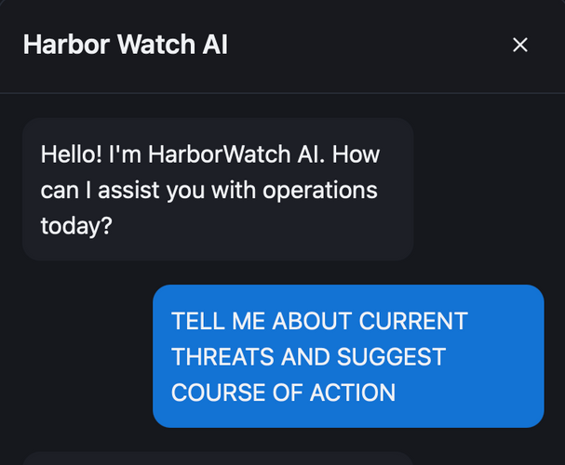
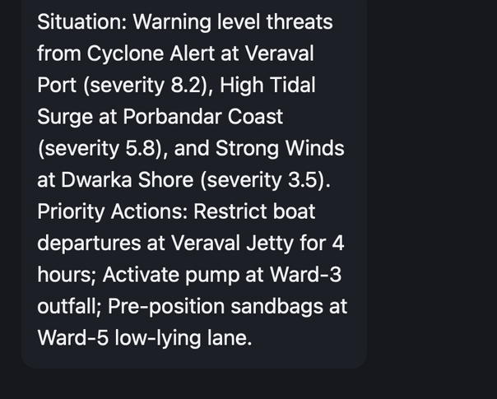
Harbor Watch
Home
About
Content
Others
Feature Overview: AI CHATBOT
VIRTUAL DECISION MAKING ASSISTANT
Our AI Decision-Making Helper, powered by Groq’s API , which models LLAMA 3, delivers fast, intelligent, and reliable support to help end user make smarter decisions and interpret huge chunks of data easily.

Slide 8
Harbor Watch
Home
About
Content
Others
Tech Stack
FRONTEND
Framework: React+ Typescript
Styling: Tailwind CSS
BACKEND
Framework: Node.js + Express
APIs
Stormglass.io, groq

Slide 9




Harbor Watch
Home
About
Content
Others
ARCHITECTURE
USER
REACT UI
BACKEND API
(NODE + EXPRESS)
STORMGLASS

Slide 10
Harbor Watch
Home
About
Content
Others
WHAT’S NEXT
Large scale expansion to citizen-orientated mobile application with capabilities such as warning notifications, feedback, and locally sourced data feeding. .
Real time IoT based data integration from sensors and satellites for more accurate prediction and multidimensional integration.
Machine Learning Based models of Early Forecasting, modeling of cause and consequences for efficient forensic analysis of disasters.
Multilingual UI for vernacular languages.

Slide 11
Harbor Watch
Home
About
Content
Others
THANK YOU
THANK YOU
THANK YOU

